Slide 1
WEL - COME

Slide 2
SCHOOL OF COMPUTER, IPS ACADEMY INDORE Hospital management system
Presented by group: -
Abhishek Mandloi
Amitansh Verma
Yuvraj Patidar

Slide 3
Presentation Outline
Introduction
Objective
Functional Requirement
Project screenshot
Conclusion

Slide 4
Introduction
The project Hospital management system includes registration of patients, storing their details into the system. The software has the facility to give a unique email, id for every patient and stores the details of every patients and the doctors automatically. Admin, Manager, and Receptionist can add, update and delete the details of doctor and the patient.
he Hospital Management System can be entered using a username and password. It is accessible either by an Admin, Manager or Receptionist. Only they can add data into the database. The data can be retrieved easily. The interface is very user friendly. The data are well protected for personal use and makes the data processing very fast.

Slide 5
Objective
Objective: -
Define hospital
Recording information about the Patients that come.
Recording information about new doctors and old doctor that come.
Recording information related to department given to Patients.
Keeping record of the appointment provided to patients.
Keeping information about various departments with diseases available to cure them.

Slide 6
FUNCTIONAL REQUIREMENT
Function 1 | Add admin
Input | Name, Username, email, mobile no, Role
Output | Database Record , Database successfully updated
Processing | Validate the given details and record the information in to the database.
Function 2 | Add doctor
Input | Fname, lname, email, qualification, mobile no, department, Date of birth, gender, address, city, state, pincode,shortbiology.
Output | Database Record , Database successfully updated
Processing | Validate the given details and record the information in to the database.
Function 3 | Add patient
Input | Fname, lname, email, mobile no, Date of birth, gender, address, city, state, pincode, shortbiology.
Output | Database Record , Database successfully updated
Processing | Validate the given details and record the information in to the database.

Slide 7
FUNCTIONAL REQUIREMENT
Function 4 | Add appointment
Input | Appointment id, patient name, department, Doctor, Date ,Time, Email, mobile no, message, appointment status.
Output | Database Record, Database successfully updated
Processing | Validate the given details and record the information in to the database.
Function 5 | Add sechedule
Input | Doctor, Available day, Start time, End time, Message, Status
Output | Database Record , Database successfully updated
Processing | Validate the given details and record the information in to the database.
Function 6 | Add department
Input | Department name, description,department status
Output | Database Record , Database successfully updated
Processing | Validate the given details and record the information in to the database.
Function 7 | Change password
Input | E-mail, Old password, new password, Confirm password
Output | Database Record , Database successfully updated
Processing | Validate the given details and record the information in to the database.

Slide 8
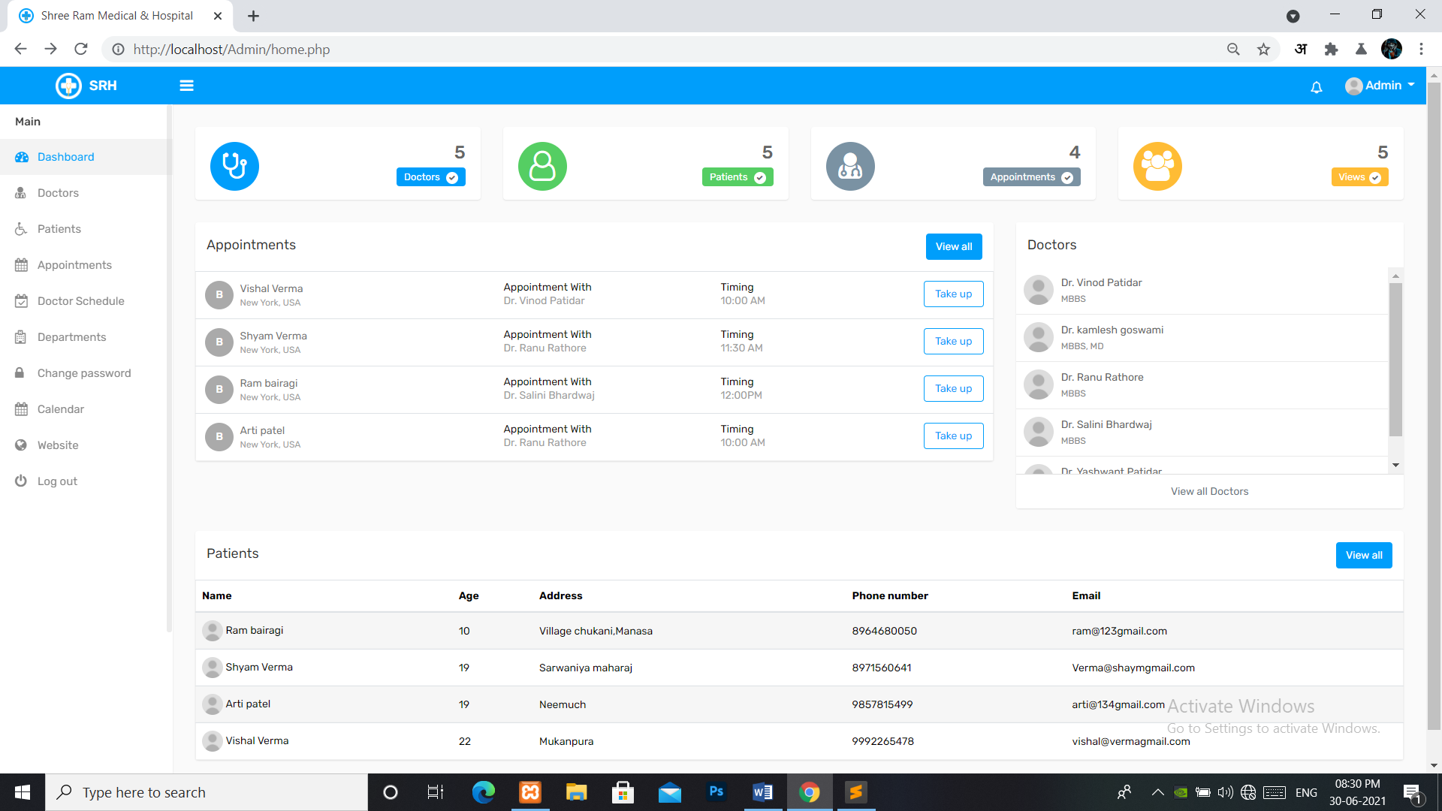
PROJECT SCREENSHOT
Dashboard:-

Slide 9
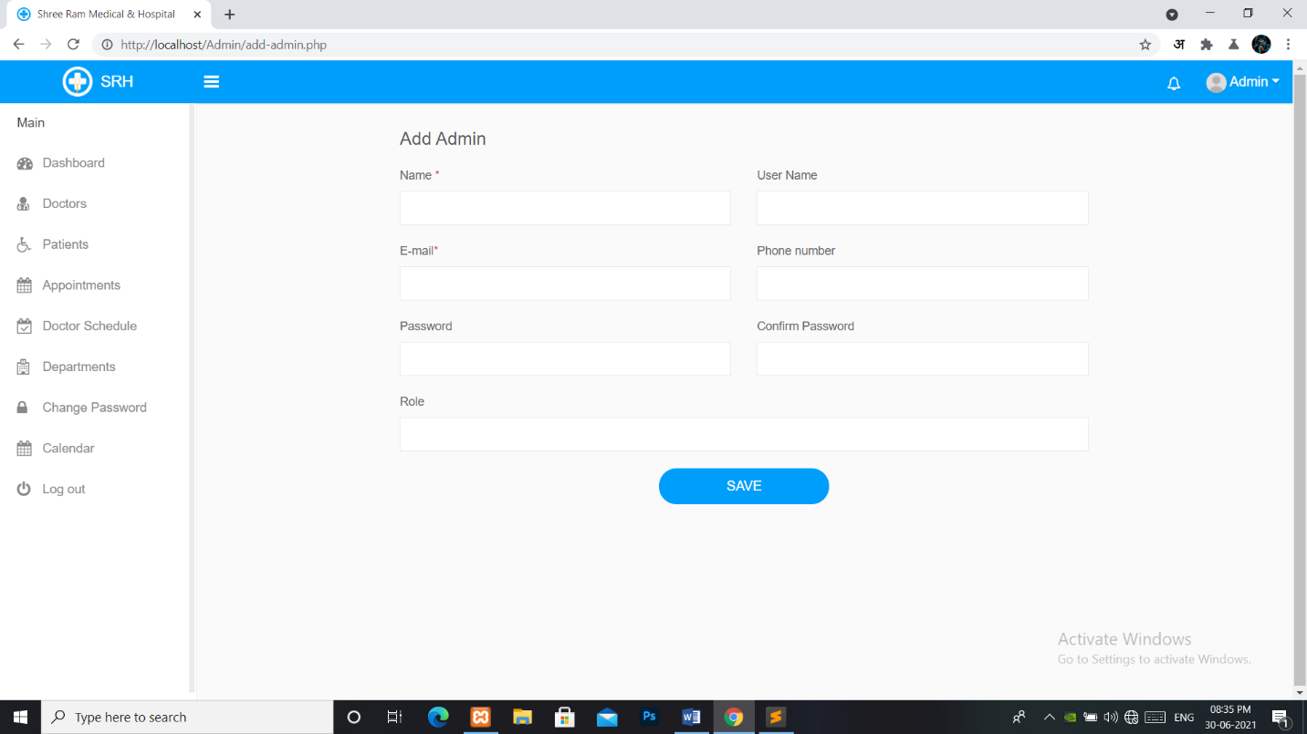
PROJECT SCREENSHOT
Add Admin: -

Slide 10
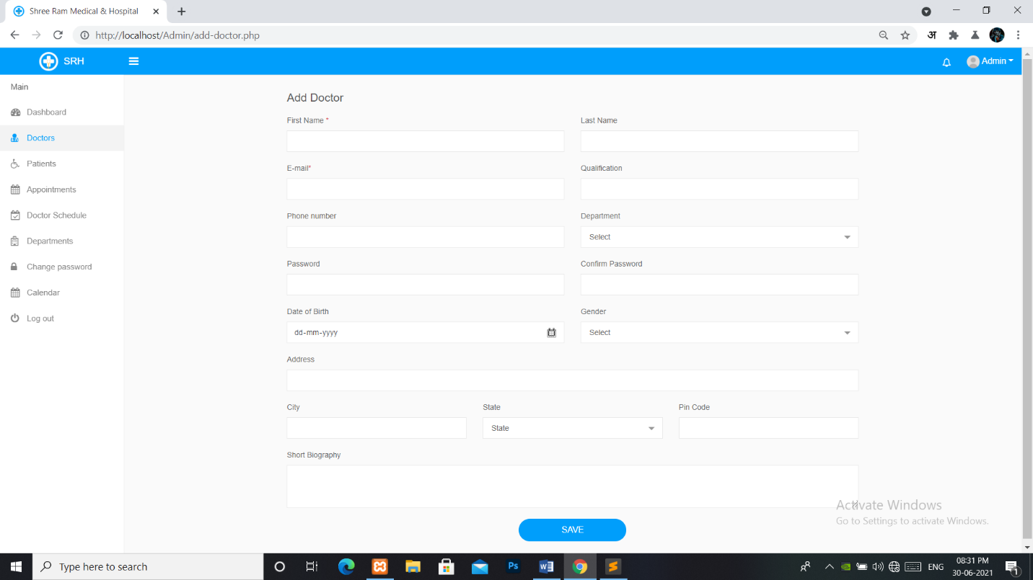
PROJECT SCREENSHOT
Add doctor: -

Slide 11
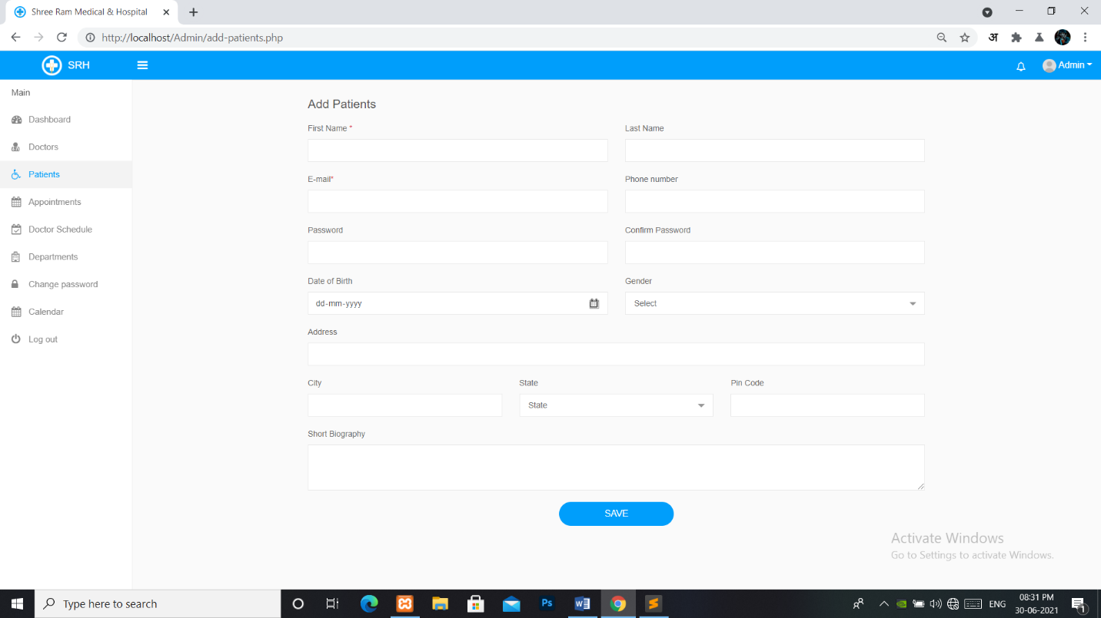
PROJECT SCREENSHOT
Add patient: -

Slide 12
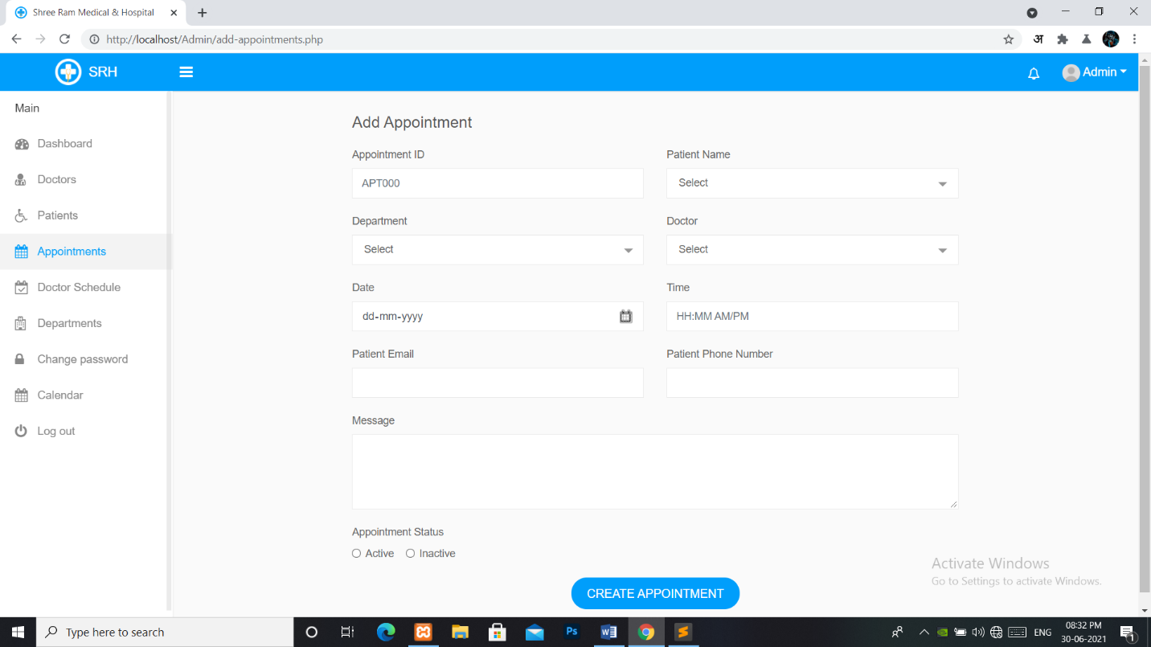
PROJECT SCREENSHOT
Add appointment: -

Slide 13
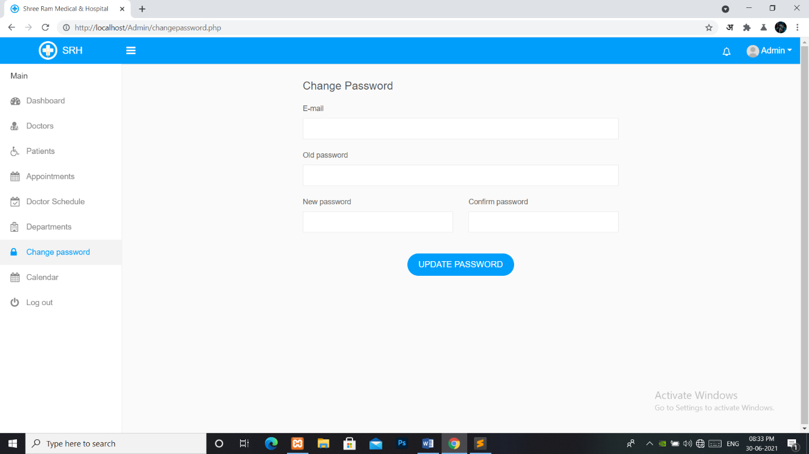
PROJECT SCREENSHOT
Change password: -

Slide 14
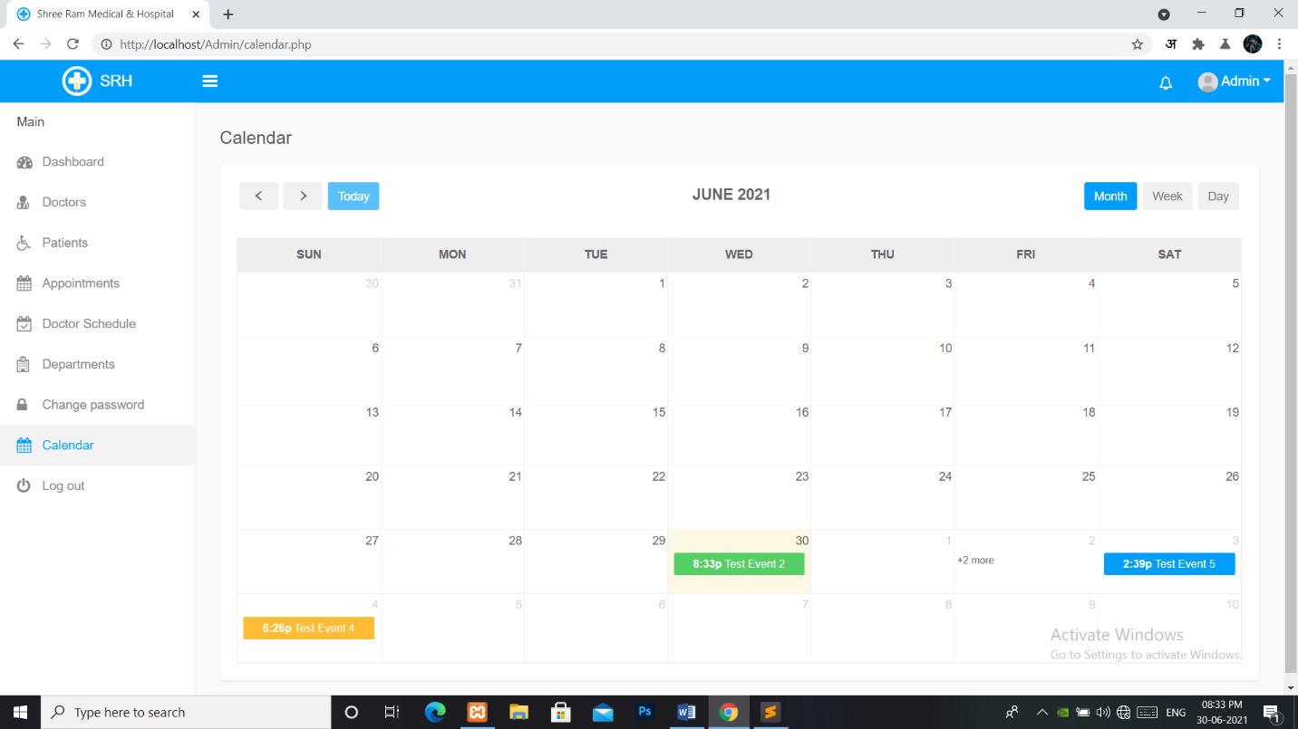
PROJECT SCREENSHOT
Calendar: -

Slide 15
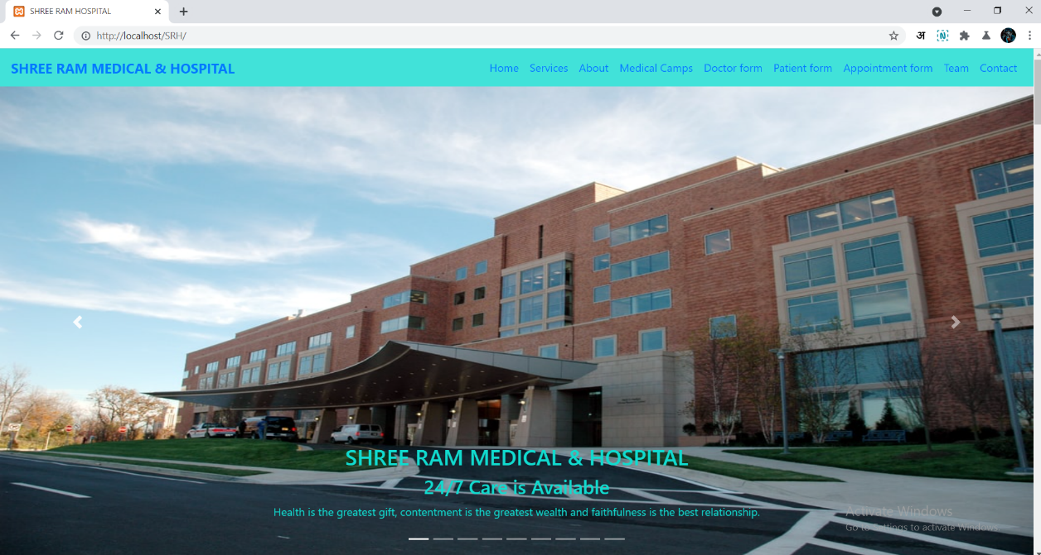
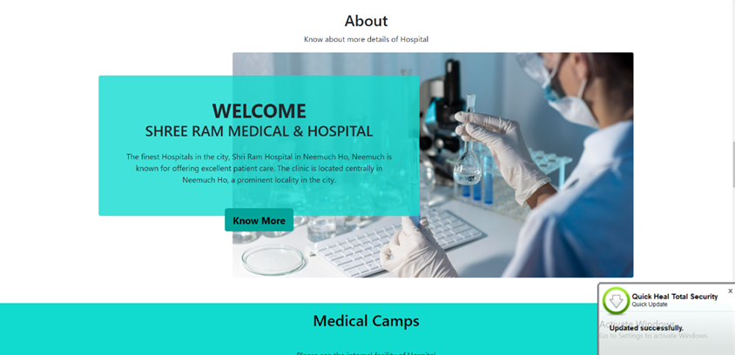

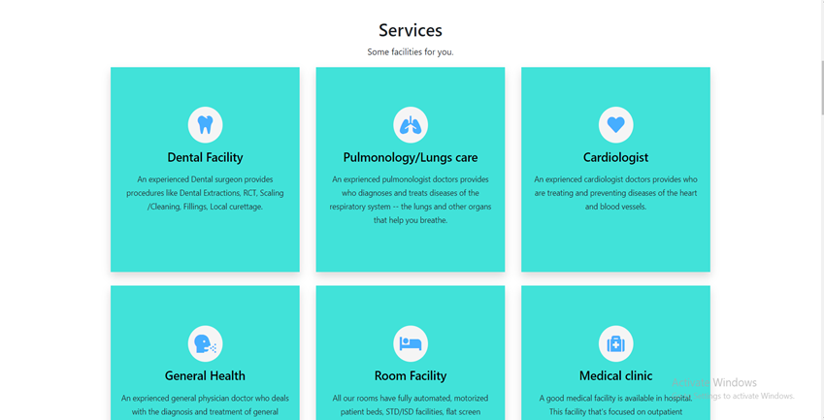

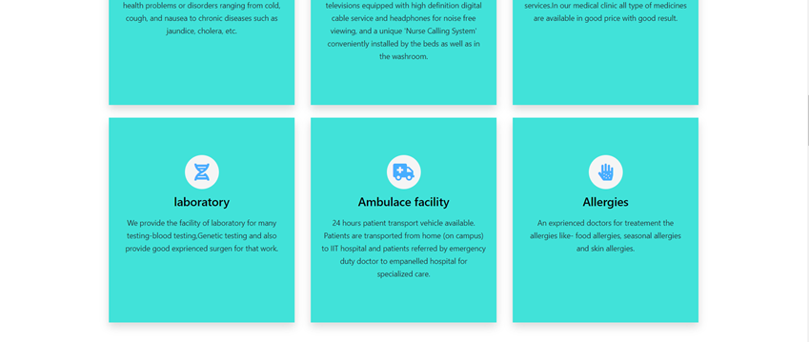
PROJECT SCREENSHOT
Website: -

Slide 16
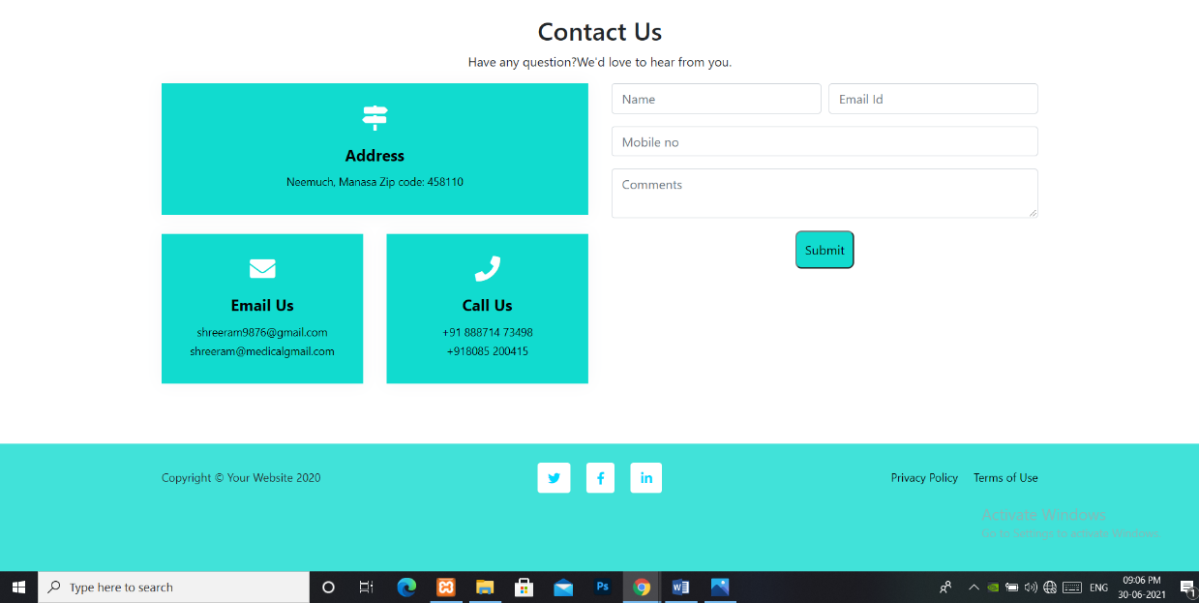
PROJECT SCREENSHOT
Website: -

Slide 17
Conclusion
Since we are entering details of the patients electronically in the” Hospital Management System”, data will be secured. Using this application, we can retrieve patient’s history with a single click. Thus, processing information will be faster. It guarantees accurate maintenance of Patient details. It easily reduces the book keeping task and thus reduces the human effort and increases accuracy speed.

Slide 18
THANK YOU

